Slide 1
Unit 7
Mining Frequent Pattern and Association

Slide 2
Frequent Pattern
Itemsets, subsequences, or substructures that appear in a data set frequently.
For example, a set of items, such as milk and bread, that appear frequently together in a transaction data set is a frequent itemset.
Motivation: Finding inherent regularities in data
What products were often purchased together?— Beer and
diapers?
What are the subsequent purchases after buying a PC?
What kinds of DNA are sensitive to this new drug?
Can we automatically classify web documents?
Applications
Basket data analysis, cross-marketing, catalog design, sale campaign analysis, Web log (click stream) analysis, and DNA sequence analysis.

Slide 3
Frequent Pattern Mining
Discovery of associations and correlations among items in large transactional or relational data sets.
With massive amounts of data continuously being collected and stored, many industries are becoming interested in mining such patterns from their databases.
The discovery of interesting correlation relationships among huge amounts of business transaction
Help in many business decision-making processes, such as catalog design, cross-marketing, and customer shopping behavior analysis.

Slide 4
Why Is Freq. Pattern Mining Important?
Freq. pattern: An intrinsic and important property of datasets
Foundation for many essential data mining tasks
Association, correlation, and causality analysis
Sequential, structural (e.g., sub-graph) patterns
Pattern analysis in spatiotemporal, multimedia, time-series, and stream data
Classification: discriminative, frequent pattern analysis
Cluster analysis: frequent pattern-based clustering
Data warehousing: iceberg cube and cube-gradient
Semantic data compression

Slide 5
Market Basket Analysis
Analyzes customer buying habits by finding associations between the different items that customers place in their “shopping baskets”.
The discovery of such associations can help retailers develop marketing strategies by gaining insight into which items are frequently purchased together by customers.
For instance, if customers are buying milk, how likely are they to also buy bread on the same trip to the supermarket?
Such information can lead to increased sales by helping retailers do selective marketing and plan their shelf space.

Slide 6
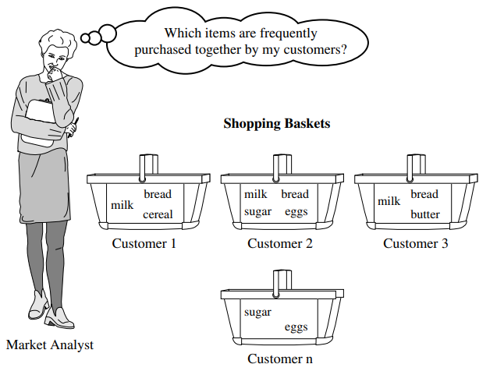
Market basket analysis

Slide 7
Association Rules
Aim to obtain rules that determine how or why certain items are linked.
Created for finding information about general if-then patterns using specific criteria.
For example, the information that customers who purchase computers also tend to buy antivirus software at the same time is represented in Association Rule
computer ⇒ antivirus software support = 2%,confidence = 60%]
A support of 2% means that 2% of all the transactions under analysis show that computer and antivirus software are purchased together.
A confidence of 60% means that 60% of the customers who purchased a computer also bought the software

Slide 8
Association Rule Evaluation Metrics
Support: how often a given rule appears in the database being mined
Confidence: the number of times a given rule turns out to be true in practice

Slide 9
Transaction | Item Occurance
T1 | A,B
T2 | A,C,D
T3 | A,B,C,D
T4 | A,D,E
T5 | B,C
One of possible Association Rule is
A => D
Total no of Transactions(N) = 5
Frequency(A, D) = > Total no of instances together A with D is 3
Frequency(A) => Total no of occurrence of A is 4.
Support = 3 / 5
Confidence = 3 / 4

Slide 10
Association Rule Mining
In general, association rule mining can be viewed as a two-step process:
1. Find all frequent itemsets: By definition, each of these itemsets will occur at least as frequently as a predetermined minimum support count, min sup. 2. Generate strong association rules from the frequent itemsets: By definition, these rules must satisfy minimum support and minimum confidence.

Slide 11
Efficient and Scalable Frequent Itemset Mining Methods
The Apriori Algorithm: Finding Frequent Itemsets Using Candidate Generation
Mining frequent itemsets for Boolean association rules.
Algorithm uses prior knowledge of frequent itemset properties.
The Apriori algorithm is the most well known association rule algorithm and is used in most commercial products.
Two steps:
a)Find all itemsets that have minimum support (frequent itemsets, also called large itemsets).
b)Use frequent itemsets to generate rules.

Slide 12
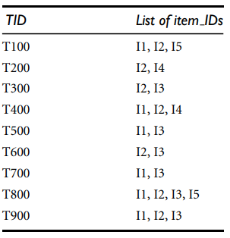
Transactional data for an AllElectronics branch.
Consider a database D , Consisting of 9 transactions.
Suppose min.support count required is 2( i..e. min_sup=2/9=22%)
Let minimum confidence required is 70%.
We have to first find out the frequent itemset using Apriori Algorithm.
Then , Association rules will be generated using min. support and min. confidence.

Slide 13
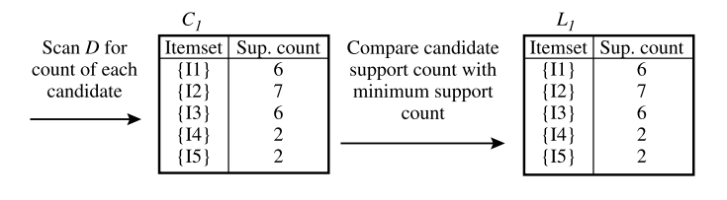
Step 1:- Generating 1-itemset Frequent Pattern
In the first iteration of algorithm, each item is a member of the set of candidate.

Slide 14
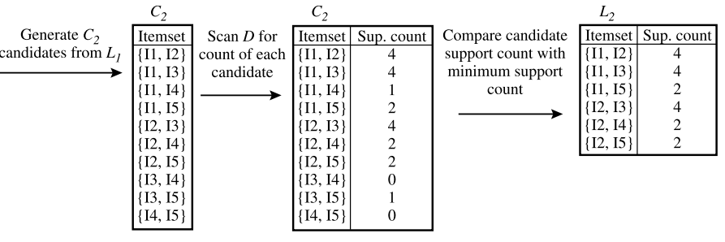
Step 2:- Generating 2-itemset Frequent Pattern
To discover the set of frequent 2-itemsets, L2, the algorithm uses L1 join L1 to generate a candidate set of 2-itemsets
The transactions in D are scanned and the support count of each candidate itemset inC2 is accumulated.
L2, is then determined, consisting of those candidate 2-itemsets in C2 having minimum support

Slide 15
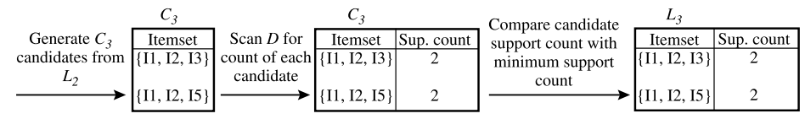
Step 3:- Generating 3-itemset Frequent Pattern
From the join step, we first get C3 = L2 join L2 = {{I1, I2, I3}, {I1, I2, I5}, {I1, I3, I5}, {I2, I3, I4}, {I2, I3, I5}, {I2, I4, I5}}.
Based on the Apriori property that all subsets of a frequent itemset must also be frequent, we can determine that the four latter candidates cannot possibly be frequent.
The transactions in D are scanned in order to determine L3, consisting of those candidate 3-itemsets in C3 having minimum support

Slide 16
Step 4:- Generating 4-itemset Frequent Pattern
The algorithm uses L3 join L3 to generate a candidate set of 4-itemsets, C4.
Although the join results in {{I1, I2, I3, I5}}, this itemset is pruned because its subset {{I2, I3, I5}} is not frequent.
Thus, C4 = φ, and the algorithm terminates, having found all of the frequent itemsets.
What is next?
These frequent itemsets will be used to generate strong association rules( where strong association rules satisfy both minimum support and minimum confidence).

Slide 17
Step 5:Generating Association Rules from Frequent Itemsets
Suppose the data contain the frequent itemset l = {I1, I2, I5}.
What are the association rules that can be generated from l?
The subsets of l are {I1, I2}, {I1, I5}, {I2, I5}, {I1}, {I2}, and {I5}.
Minimum confidence threshold = 70%
R1: I1∧I2 ⇒ I5,
confidence = sc{I1,I2,I5} / sc {I1,I2}=2/4 = 50%
R1 is Rejected.
R2: I1∧I5 ⇒ I2,
confidence = sc{I1,I2,I5} / sc {I1,I5}=2/2 = 100%
R2 is Selected.
R3: I2∧I5 ⇒ I1,
confidence = sc{I1,I2,I5} / sc {I2,I5}=2/2 = 100%
R3 is Selected

Slide 18
R4: I1 ⇒ I2∧I5,
confidence = sc{I1,I2,I5} / sc {I1}=2/6 = 33%
R4 is Rejected.
R5: I2 ⇒ I1∧I5,
confidence = sc{I1,I2,I5} / sc {I2}=2/7 = 29%
R5 is Rejected.
R6: I5 ⇒ I1 ∧ I2 ,
confidence = sc{I1,I2,I5} / sc {I5}=2/2 = 100%
R6 is Selected
In this way, We have found three strong association rules.

Slide 19
Further Improvement of the Apriori Method
Major computational challenges
Multiple scans of transaction database
Huge number of candidates
Tedious workload of support counting for candidates
Improving Apriori: general ideas
Reduce passes of transaction database scans
Shrink number of candidates
Facilitate support counting of candidates

Slide 20
Frequent-Pattern(FP) Growth Approach
“Can we design a method that mines the complete set of frequent itemsets without candidate generation?”
Divide-and-conquer strategy.
First, it compresses the database representing frequent items into a frequent-pattern tree, or FP-tree, which retains the itemset association information.
Secondly, It divides the compressed database into a set of conditional databases, each associated with one frequent item or “pattern fragment,” and mines each such database separately

Slide 21
FP Tree
Frequent Pattern Tree is a tree-like structure that is made with the initial itemsets of the database.
The purpose of the FP tree is to mine the most frequent pattern.
Each node of the FP tree represents an item of the itemset.
The root node represents null while the lower nodes represent the itemsets.
The association of the nodes with the lower nodes that is the itemsets with the other itemsets are maintained while forming the tree.

Slide 22
Frequent Pattern Algorithm Steps
1) The first step is to scan the database to find the occurrences of the itemsets in the database. The count of 1-itemsets in the database is called support count or frequency of 1-itemset.
2) The second step is to construct the FP tree. For this, create the root of the tree. The root is represented by null.
3) The next step is to scan the database again and examine the transactions. Examine the first transaction and find out the itemset in it. The itemset with the max count is taken at the top, the next itemset with lower count and so on. It means that the branch of the tree is constructed with transaction itemsets in descending order of count.
4) The next transaction in the database is examined. The itemsets are ordered in descending order of count. If any itemset of this transaction is already present in another branch (for example in the 1st transaction), then this transaction branch would share a common prefix to the root.

Slide 23
5) Also, the count of the itemset is incremented as it occurs in the transactions. Both the common node and new node count is increased by 1 as they are created and linked according to transactions.
6) The next step is to mine the created FP Tree. For this, the lowest node is examined first along with the links of the lowest nodes. The lowest node represents the frequency pattern length 1. From this, traverse the path in the FP Tree. This path or paths are called a conditional pattern base. Conditional pattern base is a sub-database consisting of prefix paths in the FP tree occurring with the lowest node (suffix).
7) Construct a Conditional FP Tree, which is formed by a count of itemsets in the path. The itemsets meeting the threshold support are considered in the Conditional FP Tree.
8) Frequent Patterns are generated from the Conditional FP Tree.

Slide 24
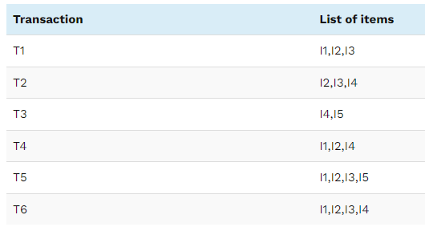
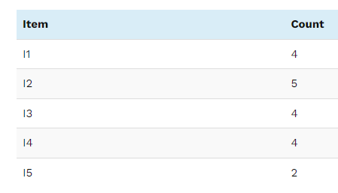
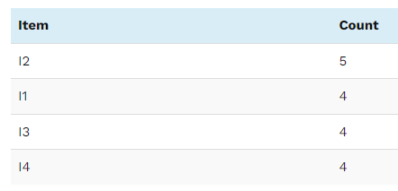
Example Of FP-Growth Algorithm
Suppose, Support threshold=50%, Confidence= 60%
Support threshold=50%
=> 0.5*6= 3
=> min_sup=3
1. Count of each item
2. Sort the itemset in descending order.

Slide 25
3. Build FP Tree
Considering the root node null.
The first scan of Transaction T1: I1, I2, I3 contains three items {I1:1}, {I2:1}, {I3:1}, where I2 is linked as a child to root, I1 is linked to I2 and I3 is linked to I1.
T2: I2, I3, I4 contains I2, I3, and I4, where I2 is linked to root, I3 is linked to I2 and I4 is linked to I3. But this branch would share I2 node as common as it is already used in T1.
Increment the count of I2 by 1 and I3 is linked as a child to I2, I4 is linked as a child to I3. The count is {I2:2}, {I3:1}, {I4:1}.
T3: I4, I5. Similarly, a new branch with I5 is linked to I4 as a child is created.
T4: I1, I2, I4. The sequence will be I2, I1, and I4. I2 is already linked to the root node, hence it will be incremented by 1. Similarly I1 will be incremented by 1 as it is already linked with I2 in T1, thus {I2:3}, {I1:2}, {I4:1}.
T5:I1, I2, I3, I5. The sequence will be I2, I1, I3, and I5. Thus {I2:4}, {I1:3}, {I3:2}, {I5:1}.
T6: I1, I2, I3, I4. The sequence will be I2, I1, I3, and I4. Thus {I2:5}, {I1:4}, {I3:3}, {I4 1}.

Slide 26
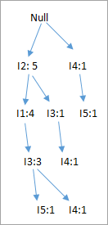
Build FP Tree

Slide 27
4. Mining of FP-tree is summarized
The lowest node item I5 is not considered as it does not have a min support count, hence it is deleted.
The next lower node is I4. I4 occurs in 2 branches , {I2,I1,I3:,I41},{I2,I3,I4:1}. Therefore considering I4 as suffix the prefix paths will be {I2, I1, I3:1}, {I2, I3: 1}. This forms the conditional pattern base.
The conditional pattern base is considered a transaction database, an FP-tree is constructed. This will contain {I2:2, I3:2}, I1 is not considered as it does not meet the min support count.
This path will generate all combinations of frequent patterns : {I2,I4:2},{I3,I4:2},{I2,I3,I4:2}
For I3, the prefix path would be: {I2,I1:3},{I2:1}, this will generate a 2 node FP-tree : {I2:4, I1:3} and frequent patterns are generated: {I2,I3:4}, {I1:I3:3}, {I2,I1,I3:3}.
For I1, the prefix path would be: {I2:4} this will generate a single node FP-tree: {I2:4} and frequent patterns are generated: {I2, I1:4}.

Slide 28
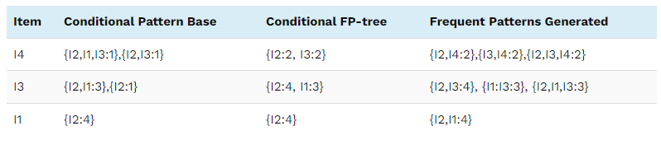
Mining the FP-tree by creating conditional (sub-)pattern bases

Slide 29
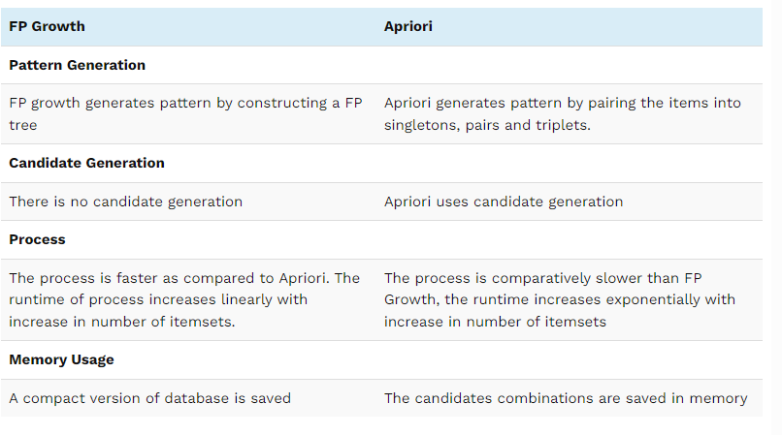

Slide 30
Advantages Of FP Growth Algorithm
This algorithm needs to scan the database only twice when compared to Apriori which scans the transactions for each iteration.
The pairing of items is not done in this algorithm and this makes it faster.
The database is stored in a compact version in memory.
It is efficient and scalable for mining both long and short frequent patterns.
Disadvantages Of FP-Growth Algorithm
FP Tree is more cumbersome and difficult to build than Apriori.
It may be expensive.
When the database is large, the algorithm may not fit in the shared memory.

Slide 31
Application of Association Rule Mining
Market Basket Analysis
Medical diagnosis
Census data
CRM of credit card business

Slide 32
Application →Medical Diagonsis
Association rules can be used in medical analysis for assisting physicians to cure patients.
The common problem of the induction of reliable analytic rules is hard as theoretically no induction process by itself can guarantee the accuracy of induced hypotheses.
Basically diagnosis is not an easy process because of unreliable diagnosis tests and the presence of noise in training examples.
This may result in hypotheses with insufficient prediction correctness which is too unreliable for critical medical applications

Slide 33
Application →Census Data
Censuses make a huge variety of general statistical information on society available to both researchers and the general community .
The information related to population and economic census can be forecasted in planning public services(education, health, transport, funds) as well as in public business(for setup new factories, shopping malls or banks and even marketing particular products).
The application of data mining techniques to census data and more generally to official data has great potential in supporting good community policy and in underpinning the effective functioning of a democratic society.

Slide 34
Application → CRM of credit card business
Customer Relationship Management (CRM), through which, banks expect to identify the preference of different customer groups, products and services adapted to their liking to enhance the cohesion between credit card customers and the bank, has become a topic of great interest .
The collective application of association rule techniques reinforces the knowledge management process and allows marketing personnel to know their customers well to provide better quality services.

